Slide 1
ROS – rqt_console and roslaunch

Slide 2
Intro
This tutorial introduces ROS using rqt_console and rqt_logger_level for debugging and roslaunch for starting many nodes at once.

Slide 3
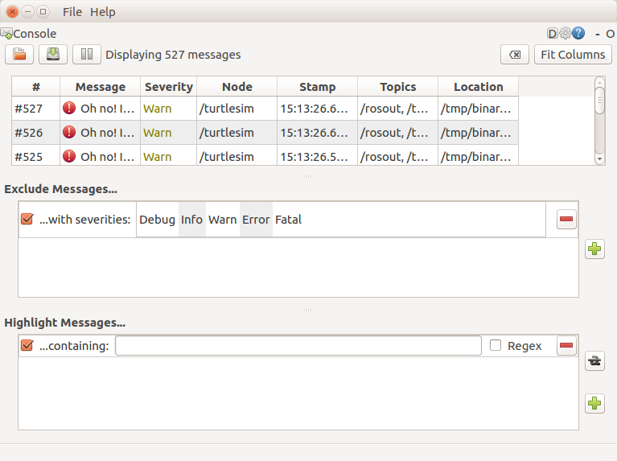
rosrun rqt_console rqt_console

Slide 4
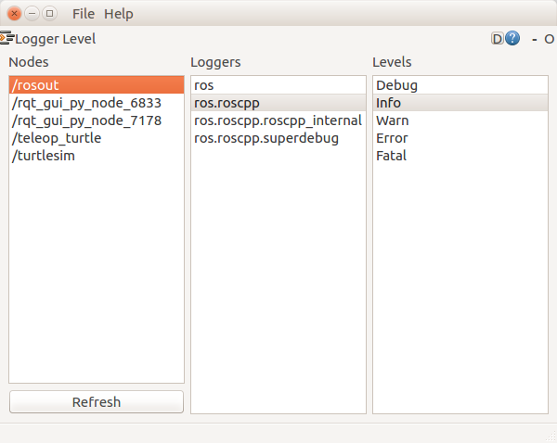
rosrun rqt_logger_level rqt_logger_level

Slide 5
roslaunch
cd ~/catkin_ws/
catkin_make
source devel/setup.bash
roscd beginner_tutorials
mkdir launch
cd launch
touch turtlemimic.launch
roslaunch beginner_tutorials turtlemimic.launch

Slide 6
turtlemimic.launch
<launch>
<group ns="turtlesim1">
<node pkg="turtlesim" name="sim" type="turtlesim_node"/>
</group>
<group ns="turtlesim2">
<node pkg="turtlesim" name="sim" type="turtlesim_node"/>
</group>
<node pkg="turtlesim" name="mimic" type="mimic">
<remap from="input" to="turtlesim1/turtle1"/>
<remap from="output" to="turtlesim2/turtle1"/>
</node>
</launch>

Slide 7
rosed
sudo install vim
rosed [package_name] [filename]
rosed beginner_tutorials package.xml
editing your ~/.bashrc file to include:
export EDITOR='nano -w'
rosed beginner_tutorials package.xml

